Slide 1
2 Thessalonians 3:16-18
(English Standard Version)

Slide 2
¹⁶ Now may the Lord of peace himself give you peace at all times in every way. The Lord be with you all.
¹⁷ I, Paul, write this greeting with my own hand. This is the sign of genuineness in every letter of mine; it is the way I write. ¹⁸ The grace of our Lord Jesus Christ be with you all.

Slide 3
Peace

Slide 5
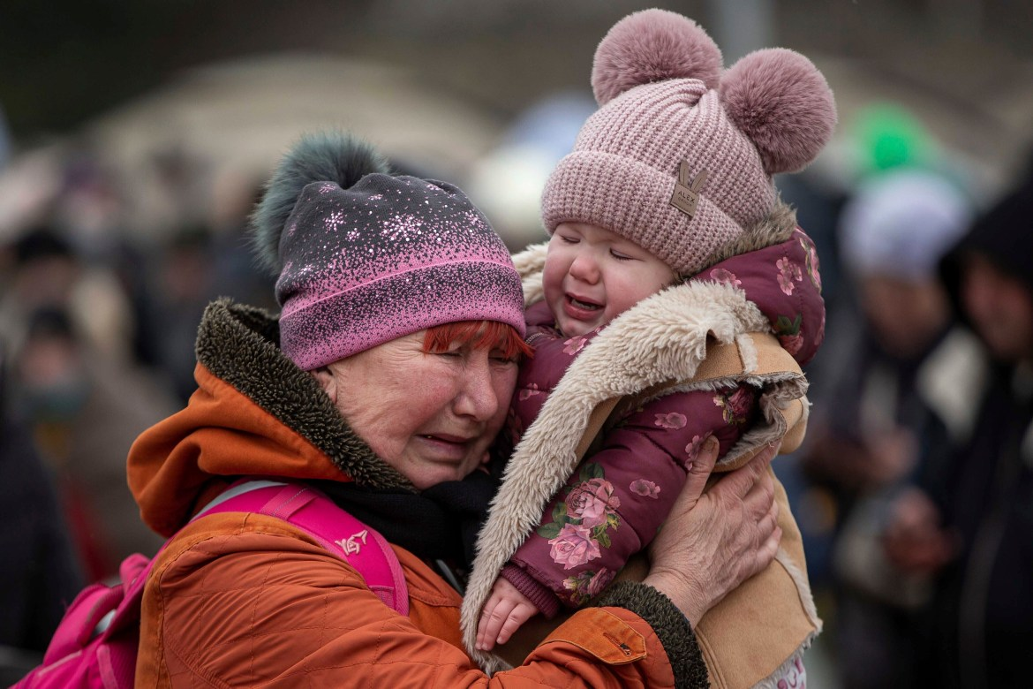
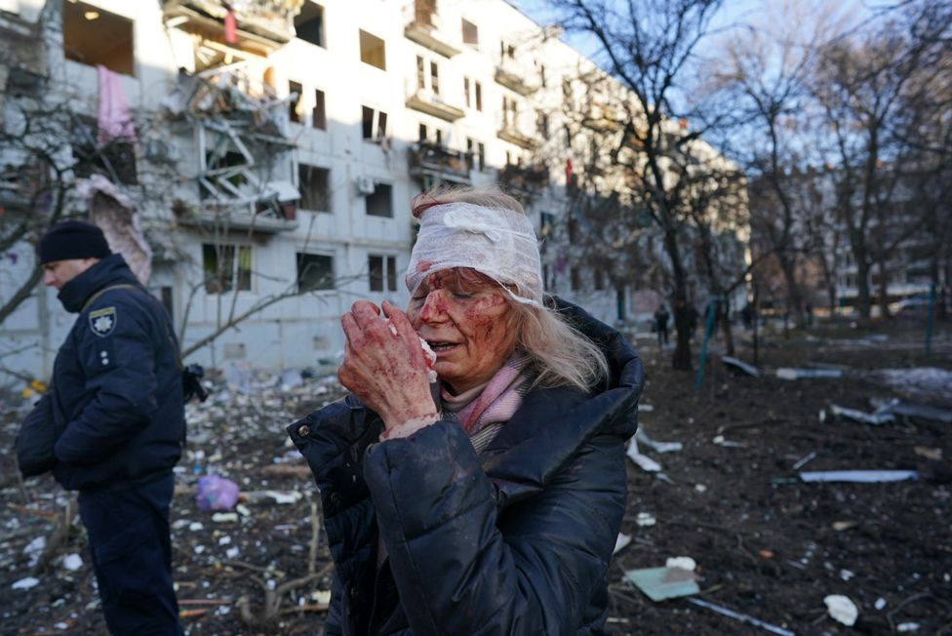
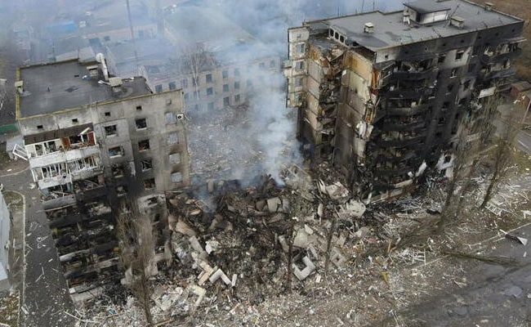

Slide 6
Peace
¹⁶ Now may the Lord of peace himself give you peace at all times in every way. The Lord be with you all.
‘Feeling’ Peace Vs. Existential Peace (actual real peace that exists)
What we often focus on
Feelings are often deceptive
Often the craving of the flesh
Biblical Peace
Present real peace between us and God
Future world peace – Christ & His eternal Kingdom
Peace at all times in every way
never without peace (even if we don’t feel it)
No matter what happens in life, we have peace.
The Lord is with us
The Lord will never forsake those whose trust is in Him.
The only thing that destroys peace between us and God, is deliberate unrepentant sin
“feeling” peace is a faith issue.

Slide 7
Romans (ESV) 5: Therefore, since we have been justified by faith, we have peace with God through our Lord Jesus Christ. ² Through him we have also obtained access by faith into this grace in which we stand, and we rejoice in hope of the glory of God. ³ Not only that, but we rejoice in our sufferings, knowing that suffering produces endurance, ⁴ and endurance produces character, and character produces hope, ⁵ and hope does not put us to shame, because God’s love has been poured into our hearts through the Holy Spirit who has been given to us.
John 16:33 (ESV) ³³ I have said these things to you, that in me you may have peace. In the world you will have tribulation. But take heart; I have overcome the world.”

Slide 8
Peace
¹⁶ Now may the Lord of peace himself give you peace at all times in every way. The Lord be with you all.
‘Feeling’ Peace Vs. Existential Peace (actual real peace that exists)
What we often focus on
Feelings are often deceptive
Often the craving of the flesh
Biblical Peace
Present real peace between us and God
Future world peace – Christ & His eternal Kingdom
Peace at all times in every way
never without peace (even if we don’t feel it)
No matter what happens in life, we have peace.
The Lord is with us
The Lord will never forsake those whose trust is in Him.
The only thing that destroys peace between us and God, is deliberate unrepentant sin
“feeling” peace is a faith issue.
Even in tribulation we have peace (even if we don’t feel it)
The deception of feelings:
The Godless may feel peace, when there is no peace.
The Christian may feel anxiety when there is real peace

Slide 9
Romans 8:5 (ESV) ⁵ For those who live according to the flesh set their minds on the things of the flesh, but those who live according to the Spirit set their minds on the things of the Spirit. ⁶ For to set the mind on the flesh is death, but to set the mind on the Spirit is life and peace. ⁷ For the mind that is set on the flesh is hostile to God, for it does not submit to God’s law; indeed, it cannot. ⁸ Those who are in the flesh cannot please God.

Slide 10
Peace
¹⁶ Now may the Lord of peace himself give you peace at all times in every way. The Lord be with you all.
‘Feeling’ Peace Vs. Existential Peace (actual real peace that exists)
What we often focus on
Feelings are often deceptive
Often the craving of the flesh
Biblical Peace
Present real peace between us and God
Future world peace – Christ & His eternal Kingdom
Peace at all times in every way
never without peace (even if we don’t feel it)
No matter what happens in life, we have peace.
The Lord is with us
The Lord will never forsake those whose trust is in Him.
The only thing that destroys peace between us and God, is deliberate unrepentant sin
Even in tribulation we have peace (even if we don’t feel it)
The deception of feelings:
The Godless may feel peace, when there is no peace.
The Christian may feel anxiety when there is real peace
To not feel peace is a faith issue.
Either I am not trusting God, or my hearts concerns are for things of the flesh.

Slide 11
Biblical examples of “I have a peace about it” method of knowing God’s will

Slide 12
Peace
¹⁶ Now may the Lord of peace himself give you peace at all times in every way. The Lord be with you all.
‘Feeling’ Peace Vs. Existential Peace (actual real peace that exists)
What we often focus on
Feelings are often deceptive
Often the craving of the flesh
Biblical Peace
Present real peace between us and God
Future world peace – Christ & His eternal Kingdom
Peace at all times in every way
never without peace (even if we don’t feel it)
No matter what happens in life, we have peace.
The Lord is with us
The Lord will never forsake those whose trust is in Him.
The only thing that destroys peace between us and God, is deliberate unrepentant sin
Even in tribulation we have peace (even if we don’t feel it)
The deception of feelings:
The Godless may feel peace, when there is no peace.
The Christian may feel anxiety when there is real peace
To not feel peace is a faith issue.
Either I am not trusting God, or my hearts concerns are for things of the flesh.
Making decisions based on “I have a peace about it” is not biblical
Feelings of “inner-calm” are more often a contentment of the flesh
The call of God will often leave us anxious because God calls us to what is hard.

Slide 13
^{Colossians 1:19–20 (ESV)} ¹⁹ For in him all the fullness of God was pleased to dwell, ²⁰ and through him to reconcile to himself all things, whether on earth or in heaven, making peace by the blood of his cross.

Slide 14
‘Feeling’ Peace Vs. Existential Peace (actual real peace that exists)
What we often focus on
Feelings are often deceptive
Often the craving of the flesh
Biblical Peace
Present real peace between us and God
Future world peace – Christ & His eternal Kingdom
Peace at all times in every way
never without peace (even if we don’t feel it)
No matter what happens in life, we have peace.
The Lord is with us
The Lord will never forsake those whose trust is in Him.
The only thing that destroys peace between us and God, is deliberate unrepentant sin
Even in tribulation we have peace (even if we don’t feel it)
The deception of feelings:
The Godless may feel peace, when there is no peace.
The Christian may feel anxiety when there is real peace
To not feel peace is a faith issue.
Either I am not trusting God, or my hearts concerns are for things of the flesh.
Making decisions based on “I have a peace about it” is not biblical
Feelings of “inner-calm” are more often a contentment of the flesh
The call of God will often leave us anxious because God calls us to what is hard.
True Peace only possible by faith in the Lord Jesus Christ
Who reconciled us to Himself by the Cross

